Slide 1
Title II-A: Supporting Effective Instruction New Jersey Association of Federal Programs Administration January 2018

Slide 2
Purpose of IIA
‘‘SEC. 2001. PURPOSE.
The purpose of this title is to –
increase student achievement consistent with the challenging State academic standards;
improve the quality and effectiveness of teachers, principals, and other school leaders;
increase the number of teachers, principals, and other school leaders who are effective in improving student academic achievement in schools; and
provide low-income and minority students greater access to effective teachers, principals, and other school leaders.
Notes:
This funding is intended to improve the professionalism of teachers and other school leaders.

Slide 3
Requirements – All Costs are:
Reasonable and Necessary
Evidence-based activities
Supplement, Not Supplant requirement
Secular, neutral, and non-ideological
Consultation-(arrive with a plan)
Needs assessment
Evidence-based intervention details
Set up future (ongoing) consultation dates
Notes:
Public school must follow state procurement requirements.
Any property remains the property of the public school. A public school can ask for computer by listing specs but the public school is not required to purchase the same brand of computer the NP school has purchased for its own school. Public school cannot reimburse the NP school.
This is the same for Title IV

Slide 4
What’s different for II-A
More opportunities
Nonpublic (NP) schools not restricted to PD
Nonpublic Ombudsman
Innovative Programs
How to recognize children affected by trauma
Helping students when there is addiction in the home
Select activities based on identified needs and evidence of effectiveness

Slide 5
What’s different for II-A
Including specialized instructional support personnel
suicide prevention
effective and trauma-informed practices in classroom management
crisis management and conflict resolution techniques
human trafficking
school-based violence prevention strategies
drug abuse prevention
bullying and harassment prevention (other than required)
Notes:
New areas of concentration now allowed under Title IIA
Talk about the Conference social/emotional development of children PD for teachers

Slide 6
Strategies
Work with local Community partners
Institutes of Higher Education
Provide PD
Pre-school Providers
Train public and preschool professionals together
Collaborate about common entrance expectations
Health professionals
Training –mental health, behavior interventions, recognizing abuse
Community organizations
Parent involvement meetings with teachers

Slide 7
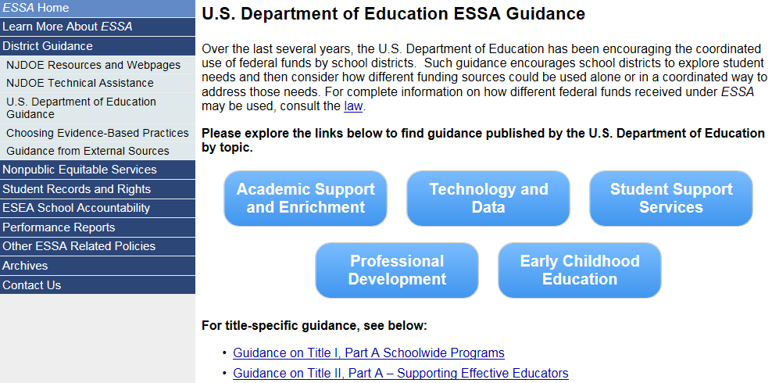
NJDOE Links to USED Guidance

Slide 8
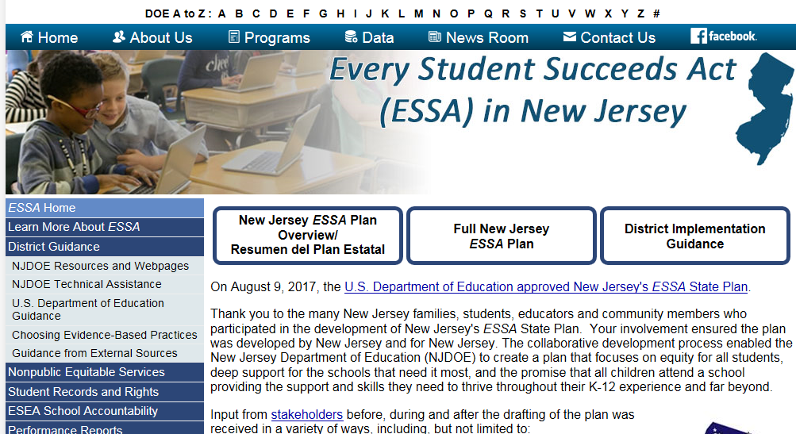
Guidance
ESSA web pages
United States Department of Education
USED ESSA web page or Office of Innovation ESSA page
New Jersey Department of Education
NJDOE ESSA web page
Notes:
Office of Innovation and Improvement
https://innovation.ed.gov/what-we-do/non-public-education/essa/

Slide 9
Resources for Planning
Needs Assessments
Evidence-Based
See NJDOE ESSA web page support ESSA implementation
West Ed - Evidence-Based Improvement: A Guide for States to Strengthen Their Frameworks and Supports Aligned to the Evidence Requirements of ESSA
U.S. Department of Education Ideas that Work Evidence-Based Module Series
State Support Network free –designed to support state and district school improvement efforts

Slide 10
Title II-A Summary
There are many opportunities with Title IIA
Review your needs, priorities and other funding sources to coordinate and compliment activities, strategies, and interventions
Please be aware that we don’t know if Title IIA will be funded from year to year when considering using these funds for salaries

Slide 11
Title IV-A: Student support and academic enrichment New Jersey Association of Federal Programs Administration January 2018

Slide 12
What’s Unique About IV-A?
Three “buckets” of funds
Activities to support Well-Rounded Educational Opportunities
Activities to support Safe and Healthy Students
Activities to support the Effective Use of Technology
If LEA allocation is under $30K
Select one, two or all three areas
If LEA allocation is over $30K
Must allocate to all three “buckets”
<15% of technology bucket can be used for devices, software and items to support blended learning

Slide 13
Examples From Non-Reg. Guidance
Table 1 page 6
Link to Guidance
Notes:
Link to U.S. Department of Education, Office of Elementary and Secondary Education, Non-Regulatory Guidance: Student Support and Academic Achievement Grants, Washington, D.C., 2016. Guidance:
https://www2.ed.gov/policy/elsec/leg/essa/essassaegrantguid10212016.pdf
See page 6
Handout

Slide 14
Well-Rounded Activities
Examples
STEM
Computer Science
Music
Science
Afterschool activities
supporting the participation of low-income students in nonprofit competitions and AP courses
World Language Activities
Financial Literacy

Slide 15
Safe & Healthy Activities
drug and violence prevention activities
school-based mental health services
integrate health and safety practices into school or athletic programs - support a healthy, active lifestyle
help prevent bullying and harassment
improve instructional practices for developing
relationship-building skills, mentoring, counseling
safe learning environments

Slide 16
Safe & Healthy Cont
including specialized instructional support personnel
suicide prevention
effective and trauma-informed practices in classroom management
crisis management and conflict resolution techniques
human trafficking
school-based violence prevention strategies
drug abuse prevention
bullying and harassment prevention (other than required)

Slide 17
Safe & Healthy Cont
Child sexual abuse awareness and prevention
Plan to reduce exclusionary discipline practices
Schoolwide positive behavioral interventions and supports
Site resource coordinator – strengthen relationships between school and community

Slide 18
ACTIVITIES TO SUPPORT THE EFFECTIVE USE OF TECHNOLOGY
to improve the academic achievement, academic growth, and digital literacy of all students
providing educators, school leaders, and administrators with the professional learning tools, devices, content, and resources to –
personalize learning
Share resources
Computer-based assessments & blended learning
Support instruction, collaboration, personalize learning

Slide 19
Technology Special Rule
A local educational agency, or consortium of such agencies, shall not use more than 15 percent of funds for purchasing technology infrastructure as described below
purchasing devices, equipment, and software applications in order to address readiness shortfalls;
Notes:
planning activities, which may include development of new instructional models (including blended learning technology software and platforms), the purchase of digital instructional resources, initial professional development activities, and one-time information technology purchases,

Slide 20
More Technology Activities
Build Technological capacity and infrastructure
Procuring content and ensuring content quality
Purchasing devices, equipment and software to address readiness shortfalls
Developing or using effective or innovative strategies for the delivery of specialized or rigorous academic courses and curricula
Blended learning projects
Professional Development in the use of technology

Slide 21
Title II –A and Title IV-A Contact Information
Sandy O’Neil
Office of Academics
TitleIVA@doe.state.nj.us

Slide 22
ESEA Nonpublic Ombudsman
Ombudsman
Statute – New Requirement
(ESEA sections 1117(a)(3)(B) and 8501(a)(3)(B)
To help ensure that private school children, teachers, and other educational personnel receive services equitable to those in public schools, State Educational Agencies (SEAs) must designate an ombudsman to monitor and enforce Title I and Title VIII equitable services requirements.

Slide 23
Ombudsman Roles and Responsibilities
Serve as an SEA’s primary point of contact for addressing questions and concerns from private school officials and LEAs regarding the provision of equitable services under Title I and Title VIII.
Serve as the primary point of contact for responding to and resolving any complaints regarding equitable services that the SEA receives under its ESEA complaint procedures.
Work with SEA staff to develop monitoring protocols applicable to the provisions of equitable services under each program.

Slide 24
Roles and Responsibilities cont.
Monitor and enforce the equitable services requirements under Titles I and VIII and, thus, should have a significant role in the State’s monitoring process.
Provide technical assistance regarding equitable services requirements for SEA staff administering applicable programs, LEA staff, and private school officials.
Participate in the State’s Title I Committee of Practitioners (ESEA section 1603(b)) and, as applicable, nonpublic schools working group.

Slide 25
ESEA Nonpublic Equitable Services
Nonpublic Ombudsman
Constance Webster, PhD
ESSA Nonpublic Ombudsman
Office of Inter-District Choice and Nonpublic Schools
New Jersey Department of Education
609-376-3662 - NEW NUMBER
NonPublic.Ombudsman@doe.state.nj.us
Notes:
Responsibilities
Intro to the purpose of this presentation

Slide 26
ESEA Consultation
The goal of consultation is agreement between the LEA and appropriate private school officials on how to provide equitable and effective programs for eligible private school children.
Notes:
The “goal of reaching agreement” is grounded in timely, meaningful, and open communication between the LEA and the private school officials
on key issues that are
relevant to eligible private school students, teachers and other education personnel, and families

Slide 27
Consultation
Meaningful consultation provides ample time and a genuine opportunity for all parties:
to express their views,
to have their views seriously considered,
to discuss viable options for ensuring equitable participation of eligible private school students, teachers and other education personnel, and families.

Slide 28
Consultation
Assumes that the LEA has not made any decisions that will impact the participation of private school students and teachers in applicable programs prior to consultation, or established a blanket rule that precludes private school students and teachers from receiving certain services authorized under applicable programs.
Notes:
Very important – has not made any decsisions

Slide 29
Consultation
Successful consultation:
Begins well before the implementation of services,
Establishes positive and productive working relationships,
Makes planning effective, continues throughout implementation of equitable services,
Serves to ensure that the services provided meet the needs of eligible students and teachers.
Notes:
The LEA is the stewart of the federal funds. It is your responsibility to monitor the implementation of the programs implemented within the NP schools
Therefore, the remainder of this presentation is going to discuss topics for “on-going” consultation as it looks like throughout a grant year

Slide 30
Timeline for Consultation
Winter
What you should currently be discussing with NP schools
Notes:
At this point in the grant year – the following is what should be discussed in ‘on-going’ consultation. Please note that at this stage of the grant process consultation does not necessarily have to be in person.
Some of you have only one or two schools NP schools that you work with. Others have more complicated demands from your NP
At this stage of the grant cycle you can determine whether you want a face to face meeting, email, phone calls.
Either way it is required that you address the following:

Slide 31
Winter Consultation
Assess current program effectiveness
Evaluate programs and services being implemented in current school year and
Analyze needs for upcoming program year
how-when-where-by whom - make suggestions for modifying programs that will be implemented in next school year
Discuss available funds
Notes:
Your programs must be up and running - no excuses!
At this point in the grant cycle programs should be showing some level of effectiveness. Discuss how success is measured
It is important that NP schools collect data regarding the effectiveness of the program/s they are running
This data will help with planning for the coming school year and is required from the Federal Govt.
Draw down the funds. Keep the NP school updated on where they are with the expenditure of funds. Try to avoid carryover. Remind the NP school that any carryover gets put back into the general pot and distributed to all participants on a % the following year. So, their funds do not stay with the school. Its best to spend the $$
Also, it is important the all state funded programs be drawn down – there is no NP state carryover so if its not spent they lose the money – this is unacceptable!

Slide 32
Timeline for Consultation
Spring
Notes:
Hands down the busiest time of the year.
This is when you begin to prepare for the coming school year. Spring really means beginning at the latest March
Reach out to consult – phone calls, in-person visits, e-mails, regular mail, registered/certified mail,

Slide 33
Spring Consultation
Work with NP officials to design programs for next year
Emphasize data driven program development
Discuss funding
Discuss remaining funds
There is NO carryover for state funds – so get that money spent!
85% of last years equitable share for planning next grant year programs
Notes:
Have nonpubs look at data from last grant years programs. What's worked – needing to be changed. How will this years grant $$ be spent – addressing what identified issues.

Slide 34
Spring Consultation
Invitations sent to nonpublic families via nonpublic school to determine eligibility (Title I)
Collect nonpublic student eligibility forms - ex: Free/Reduced lunch (Title I)
Forms on ESSA website
Establish entrance/exit criteria (Title I)
Pooling of funds
Pooling funds is within one program area – ie. Title I-A funds cannot be pooled with II-A funds
Notes:
All forms mentioned on this slide are on the essa website under equitable services
Each title has some unique info that must be discussed – on this slide we are just talking about title I
The earlier you get the NP to begin the process of collecting Poverty data the easier it will be to report the data in the EWEG grant
In every consultation conversation you always want to update the NP on their expenditure of funds. Don’t leave it a mystery be forthcoming in the $$ - It builds trust between each group
Pooling of funds – be sure to discuss this with your NP – especially if you have a number of small NP in your sending area and all receiving a small amount of equitable share – Pooling allows the NP to combine their equitable share it run a program that will benefit all eligible students with a larger amount of $$
Exit /entrance – this is required and is requested confirmation as part of the EWEG application

Slide 35
Spring Consultation
LEA/NP consult on 85% of last years equitable share
Size and scope of services
Program implementation
Transferability
Notes:
Start consultation - Don’t use the excuse – well I haven’t gotten my allocation yet – consult on 85% of the allocation. You can get far with that conversation!
Remember no decisions are made prior to consultation (transferring funds)
NP should be able to support through data the programs that they would like to run with their equitable share. It is OK and expected that the LEA will ask for this information
Also, regarding transferability. You must consult prior to any transfer! Emphasis on must! We are trying to get word from the Feds regarding this new option. Please be aware how much a NP school is negatively impacted by this process. Use Title I as an example

Slide 36
Spring Consultation
3rd party provider
LEA makes decision regarding the delivery of services of NP - if NP disagrees LEA must provide in writing an analysis of reasons why the LEA has chosen not to use a specific contractor
Who, where, how program implementation
Delivery of services
Notes:
I cannot emphasize enough the importance of having this discussion!!
Be forthcoming about who you are using. Remember that the choice of provider must be done in consultation with the NP – the ultimate decision resides with the public school BUT you must consult and if there is a disagreement you must provide a explanation why you chose the vendor that you did.
Also remember, you are not to relinquish all control to the 3rd party provider. you are the steward of the funds – the 3rd party provider works for you – if trouble arises I am coming to you not the 3rd party provider so pay attention!
Use west NY as an example

Slide 37
Spring Consultation
Signed consultation forms uploaded into Homeroom
ESEA Application due to the NJDOE
Notes:
You’ve done everything you needed to do now get the signature from the NP and upload into homeroom
This is new from last year and will be closely monitored this year
The form is being updated for this year

Slide 38
Suggested Timeline for Consultation
Summer

Slide 39
Summer Consultation
Discuss use of 3rd party vendor to provide services
Begin summer program
Notes:
You can begin programs without final approval of the application
The application is substantially approved when it is submitted in EWEG. If a NP wants to run a summer program get it started – do not hold them up!!

Slide 40
Suggested Timeline for Consultation
Fall

Slide 41
Fall Consultation
School starts
Programs start
Order supplies and materials if necessary
Notes:
Again remember that programs can and should be run minus prior final application approval.

Slide 42
Fall Consultation
LEA prior year final report due
Once approved complete amendment to move carryover funds into the current grant year
Discuss equitable share of any carryover funds
Notes:
The Final report is important for the NP school. This is where any carryover get redistributed into the current year grant application. The LEA is obligated to consult with the NP to determine how any carryover will be expended in the new grant years application.

Slide 45
Fall Consultation
Program evaluation
Analyze needs
Discuss expenditure of funds
Notes:
In late fall you should be reminding your NP to begin analyzing their programs – do they need any tweaking, is there any necessary programmatic changes? Begin collecting data on effectiveness of program
Draw down funds.

Slide 46
Evaluate Services
Begin the cycle again – always working towards refining the use of federal funds to provide the best services to your eligible students, parents and their families.

Slide 47
Strengthening the Effectiveness of ESEA Investments
Notes:
Non-Regulatory Guidance: Using Evidence to Strengthen Education Investments, Sept. 16, 2016 p. 3 -6
Step 1. IDENTIFY LOCAL NEEDS -Spring
Step 2. SELECT RELEVANT, EVIDENCE-BASED INTERVENTIONS - Spring
Step 3. PLAN FOR IMPLEMENTATION - Spring
Step 4. IMPLEMENT – summer, fall
Step 5. EXAMINE AND REFLECT - winter
We are leaning on this for NP to look at the effictiveness of their programs

