Slide 1
FY 2016 ESEA/NCLB Title II, Part A New Jersey Association of Federal Program Administrators
Presented by:
Sandy O’Neil
Title II, Part A Coordinator
New Jersey Department of Education
April 23, 2015

Slide 2
Title II, Part A - §2101
Purpose:
Increase student academic achievement through strategies such as improving teacher & principal quality and increasing the number of highly teachers in classrooms and highly qualified principals & assistant principals in schools; and
Hold LEAs and schools accountable for improvements in student academic achievement.

Slide 3
High Quality Professional Development
Professional development that meets the criteria contained in Title IX, §9101(34) of ESEA.
Includes, but is not limited to, activities that:
Improve & increase teachers’ knowledge of academic subjects and enable teachers to become highly qualified;
Are an integral part of broad schoolwide & districtwide educational improvement plans;
Give teachers & principals knowledge & skills to help students meet challenging State academic standards;

Slide 4
High Quality Professional Development
Improve classroom management skills;
Are sustained, intensive, & classroom-focused and are not one-day or short-term workshops;
Advance teacher understanding of effective instruction strategies that are based on scientifically based research; and
Are developed with extensive participation of teachers, principals, parents, and administrators.

Slide 5
Class Size Reduction (CSR)
Common Misunderstanding
LEAs may reduce class sizes by creating additional classes in a particular grade or subject and placing highly qualified teachers hired with program funds in those classes.
Be mindful of Supplement not Supplant rules.

Slide 6
Teacher/Principal Evaluation Systems
Connected to an allowable, IIA activity
Must supplement, not supplant state/local funds
Cannot be utilized for student-specific activities
Notes:
IIA funds can be used for the development of teacher and/or principal evaluation systems, as long as these systems are integral to the implementation of one or more of the following allowable uses as defined in the IIA regulations at: http://www2.ed.gov/policy/elsec/leg/esea02/pg22.html#sec2123.
Support activities that ensure teachers are able to use challenging State academic content standards & student achievement standards, and State assessments, to improve instructional practices & improve student learning.
Allows for development & implementation of mechanisms to assist LEAs and schools to effectively retain HQT and principals.
Permits LEAs to use funds to reform tenure systems.
Allows LEAs to develop merit-based performance systems & strategies to provide differential & bonus pay for teachers in high-need academic subjects, such as reading, mathematics, & science, and teachers in high-poverty schools and districts.
Allows LEAs to develop & implement PD programs for principals that enable principals to be effective school leaders and prepare all students to meet challenging State academic content & student academic achievement standards.
Allows LEAs to develop teacher advancement initiatives that promote professional growth & emphasize multiple career paths and pay differentiation.

Slide 7
Supplement vs. Supplant
Common Misunderstanding
ESEA §2123(5)(10)(b) Local Use of Funds: Supplement, Not Supplant; 2 CFR 225 (OMB Circular A-87), Attachment A, Section C.1: Basic Guidelines (Factors affecting allowability of costs
Title II-A, Principal Training and Recruiting Funds, are for teacher and/or principal professional development and cannot be used for student use or activities that the district would otherwise carry out in the absence of these funds. As a result, the district’s use(s) of Title II-A funds for the expenditures listed below supplants state and local funds

Slide 8
Using II-A Funds for Evaluation Systems
Not Allowable:
Sole development of an evaluation system for teachers and/or principals is not in itself an allowable use of Title II-A funds.

Slide 9
Using II-A Funds for Evaluation Systems
Allowable:
Development of such systems to inform decisions on the following:
Professional Development
Promotion
Retention
Compensation
Tenure

Slide 10
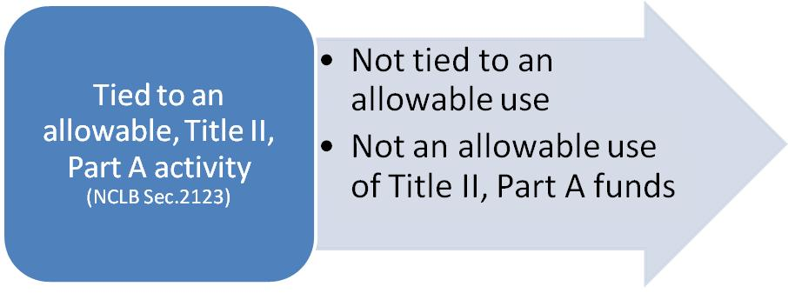
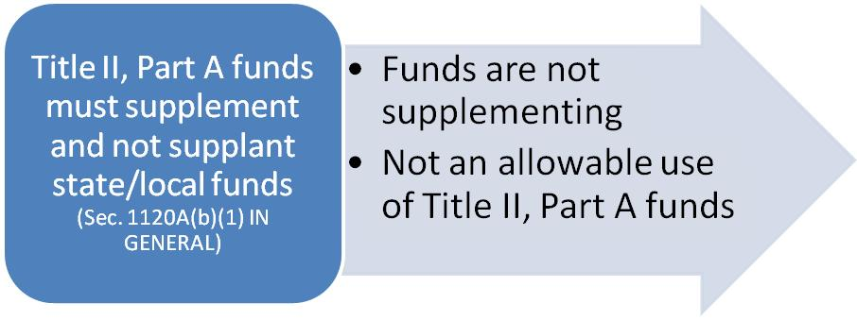
Using II-A Funds for Evaluation Systems
NO
NO

Slide 11
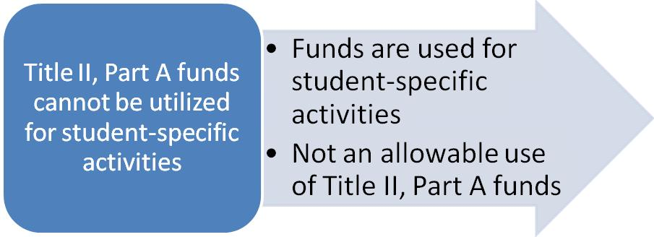
Using II-A Funds for Evaluation Systems
NO
Given the above, Title II-A funds may be utilized for the development of teacher and principal evaluation systems, as long as these systems are integral to the implementation of one or more of the following allowable uses as defined in the Title II, Part A regulations. Specific examples can be found on the NJDOE web site.
Notes:
(see Sec. 2123 Local Use of Funds http://www2.ed.gov/policy/elsec/leg/esea02/pg22.html#sec2123).
See handout titled: “Using Title II-A Funds for Teacher/Principal Evaluations” for examples. Please send specific requests to Sandy O’Neil at sandy.oneil@doe.state.nj.us to be evaluated on a case-by-case basis if they do not align with Section 2123.

Slide 12
Title II, Part A: Allowable Uses
Include, but are not limited to, the following:
Recruitment and Retention
Incentives
Establishing Programs
Professional Development Activities
Research based
Ongoing, sustained
Leadership Academies
Teacher Advancement Initiatives
Professional Development Assessment Tools

Slide 13
Nonpublic Consultation
LEA must consult with nonpublic school officials during the design, development, and implementation of the professional development program
LEAs may not give a check to nonpublic school official
Nonpublic school official can decline to participate
Services must be secular, neutral, and non-ideological

Slide 14
Nonpublic Professional Development and Stipends
Funds may be used to pay stipends to nonpublic school teachers participating in professional development activities and must be paid directly to the nonpublic school teachers for their own use, and not to the nonpublic school.
Funds may not be used to pay for substitute teachers for nonpublic school teachers who attend professional development activities.
Notes:
No direct instruction
Sec. 9102
Under the Title II, Part A program, private school teachers, principals, and other educational personnel are eligible to participate to the extent that the LEA uses funds to provide for professional development for teachers and other school personnel.

Slide 15
Food
No
Never breakfast
(State regulation)
Exception: when a keynote speaker is speaking during lunch
Call the IIA Program Coordinator for clarification, if needed

Slide 16
Questions?
Sandy O’Neil
sandy.oneil@doe.state.nj.us
609-777-4662

